Slide 1
The Who and the How? Key components of recruiting highly qualified STEM teachers
Anica Bowe, PhD Student; Christina Madsen, M.Ed; Frances Lawrenz, PhD.
University of Minnesota

Slide 2
The Challenge
There is a lack of highly qualified STEM teachers in high need schools (Clewell & Villegas, 2001)
High need schools have a higher percentage of new teachers, a lower percentage of certified teachers, and more teachers with weaker education backgrounds (Lankford, Loeb, & Wyckoff, 2002)
STEM teachers are more likely to leave because of job dissatisfaction than other teachers (Teacher Follow-up Survey (2004-2005) IES, May 2008)

Slide 3
The role of Traditional and Alternative programs
Alternative programs: candidate can become teacher of record within the few weeks of their teacher prep program
Traditional programs generally provide more pedagogical and clinical training
Alternative programs allow individuals who already have strong content knowledge to enter the profession at a more accelerated pace
There is, however, a need for more comparative research on how alternative and traditional alternative programs are actually recruiting STEM teachers

Slide 4
Study
Comparisons were made between Noyce scholars enrolled in alternative versus traditional programs.
Five questions drove the research:
What were the recruiting and screening strategies used?
What were the demographic characteristics of the scholars enrolled in both types of programs?
What were the specific “affective” characteristics of scholars who remained in high need school settings?
How influential was the Noyce funding on scholars decisions to become teachers?
How influential was the Noyce funding on scholars decisions to teach in high need schools?

Slide 5
Methodology
Data came from a 4-year comprehensive evaluation of the Noyce program
A mixed methods approach using survey and interview data was employed
Survey data came from 66 Noyce PIs and 507 Noyce scholars
Interview data came from 19 district representatives and 39 scholar interviews

Slide 6
Analyses
Descriptive analyses of survey data using graphs and tables
Chi-square and one-way ANOVA of survey data examining differences between alternative and traditional programs
An iterative grounded theory approach of all interviewee responses were coded in NVivo with codes originating from the data

Slide 7
Recruiting strategies (Advertising)
“Other” included radio and newspaper ads, flyers, word of mouth, and recruiters.

Slide 8
Recruiting strategies (Screening Criteria)

Slide 9
Demographic characteristics (Gender)

Slide 10
Demographic characteristics (Race)

Slide 11
Affective Characteristics

Slide 12
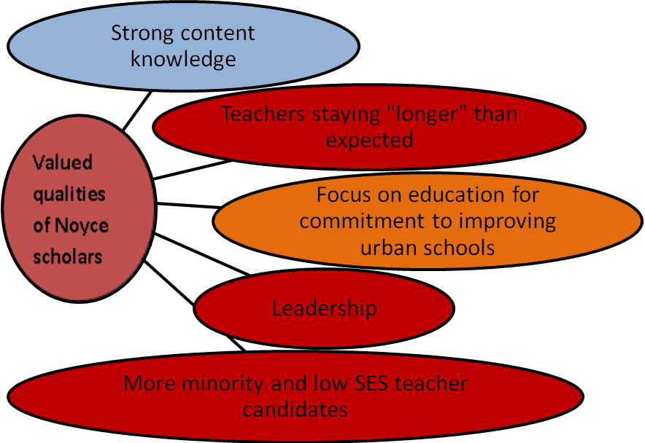
Affective Characteristics
District personnel perceptions of Noyce scholars
Colors indicate number of participants mentioning items
0-5 responses RED
6-10 responses ORANGE
11-13 responses BLUE
Scholar interview data showed that Noyce scholars who remained in high need schools:
Had a desire to give back
Wanted to make a difference
Had past experience with high need populations
Strong connections to local community

Slide 13
Influence of the Noyce scholarship on scholars’ decisions to teach in a high need school

Slide 14
Influence of the Noyce scholarship on scholars' decisions to become a teacher

Slide 15
Implications (True for both)
  Our data show there are no differences between traditional and alternative programs who receive Noyce funding in terms of advertising, screening, and population.
No difference in race is in contrast to other studies (Clewell & Villegas, 2001) and it may be because the Noyce program in general attracts a higher percent of minorities (33%) compared to the national average (9-14% depending on subject and grade range (Weiss, Banilower, & Smith, 2001)).
Nevertheless, more efforts to recruit from minority populations are still warranted and culturally tailored advertising may be more appropriate (Keyzer et. al., 2005).

Slide 16
Implications
  Districts have specific needs and are willing to hire teachers that meet those needs, thus supporting a grassroots approach (The NCCTQ, 2006).
Programs should be careful who they recruit.
    content experts
    highly committed to high need schools
The Noyce funding is more effective in encouraging scholars to teach in high need settings than encouraging them to become teachers.

